Slide 1
ECE Praesidium
Hellenic Entomological Society
Organizers
PCO

Slide 2
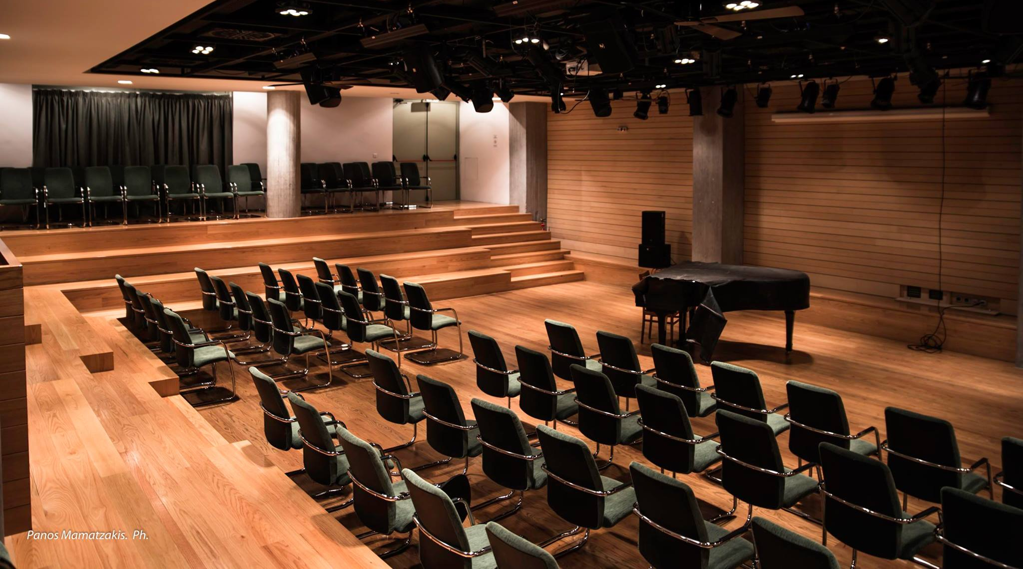
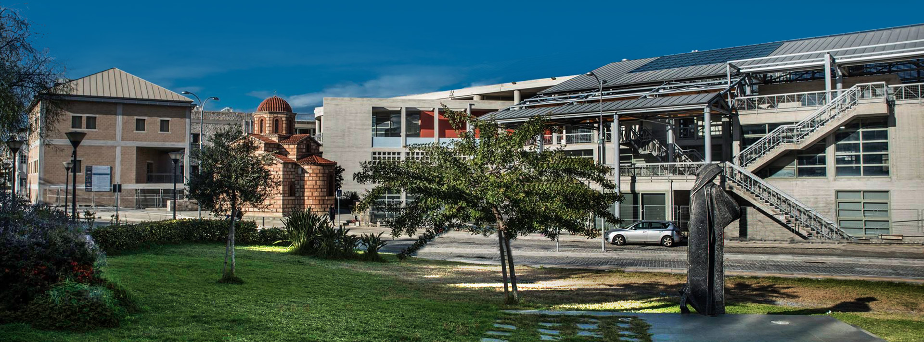
Congress Venue Cultural Conference Center of Heraklion

Slide 3
16 Thematic Sessions
Morphology and Systematics
Genetics and evolutionary biology
Physiology and Biochemistry
Ecology and Behavior
Multitrophic Interactions
Insect Biotechnology
Symbiosis and Insect Pathology
Urban and Forest Entomology
Medical and Veterinary Entomology
Invasion biology and climate change
Biodiversity and Conservation
Social Insects and Apidology
Toxicology and pesticide resistance
Biological Control and Biopesticides
Integrated Pest Management
Stored Product Protection

Slide 4
Scientific Committee
62 members
From 14 countries: Belgium, Cyprus, Denmark, France, Germany, Greece, Israel, Italy, Kingdom, Netherlands, Portugal, Spain, Turkey, United Kingdom

Slide 5
Program outline
Monday 16/10 up to 4 thematic sessions
Tuesday 17/10 up to 4 thematic sessions
Wednesday 18/10 up to 4 thematic sessions
Thursday 19/10 up to 4 thematic sessions
Friday 20/10 up to 4 thematic sessions – half day
+ 1 plenary speaker per day

Slide 6
Important dates
Call for Abstracts is open
Abstract submission till 27/02/2023
Authors notification 31/03/2023
Early bird registration deadline 29/05/2023

Slide 7
Registration fees Early bird deadline 29.05.2023
Registration type | €
Delegates early | 575
Delegates late | 675
Students early | 225
Students late | 275

Slide 8
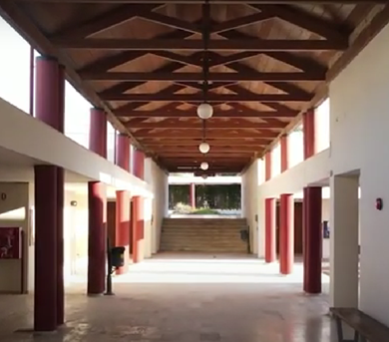
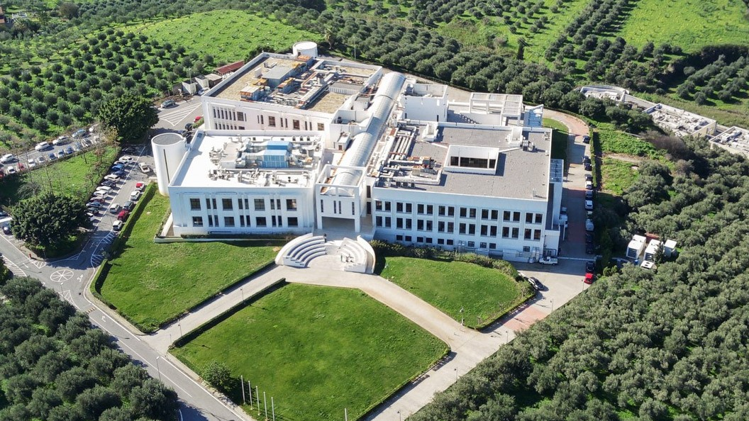
Location Heraklion, Crete, Greece
Institutions based in the city
University of Crete
Hellenic Mediterranean University
Foundation for Research and Technology - Hellas
Hellenic Agricultural Organization ELGO - DIMITRA

Slide 9
Special rates for all participants Accommodation

Slide 10
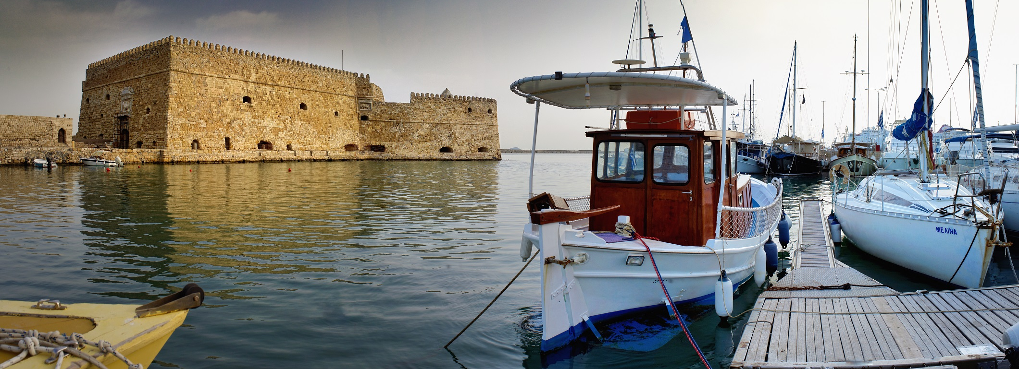
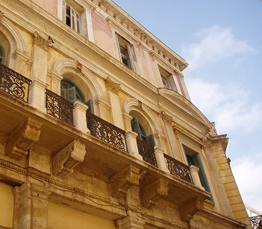
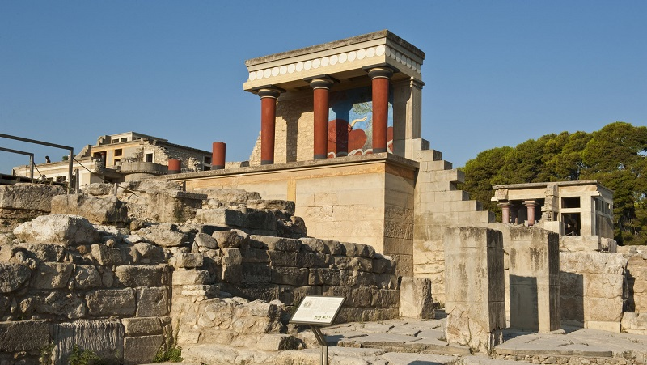
Location Heraklion, Crete, Greece
Top destination!
Contemporary infrastructure
High quality services
Nature
History & culture
Gastronomy & nightlife

Slide 11
Spread the news!
Visit the Congress website www.ece2023.com
1st Announcement
Call for Abstracts
Communications Kit: poster & web banners
Follow us on Social Media Facebook, LinkedIn, Twitter

Slide 12
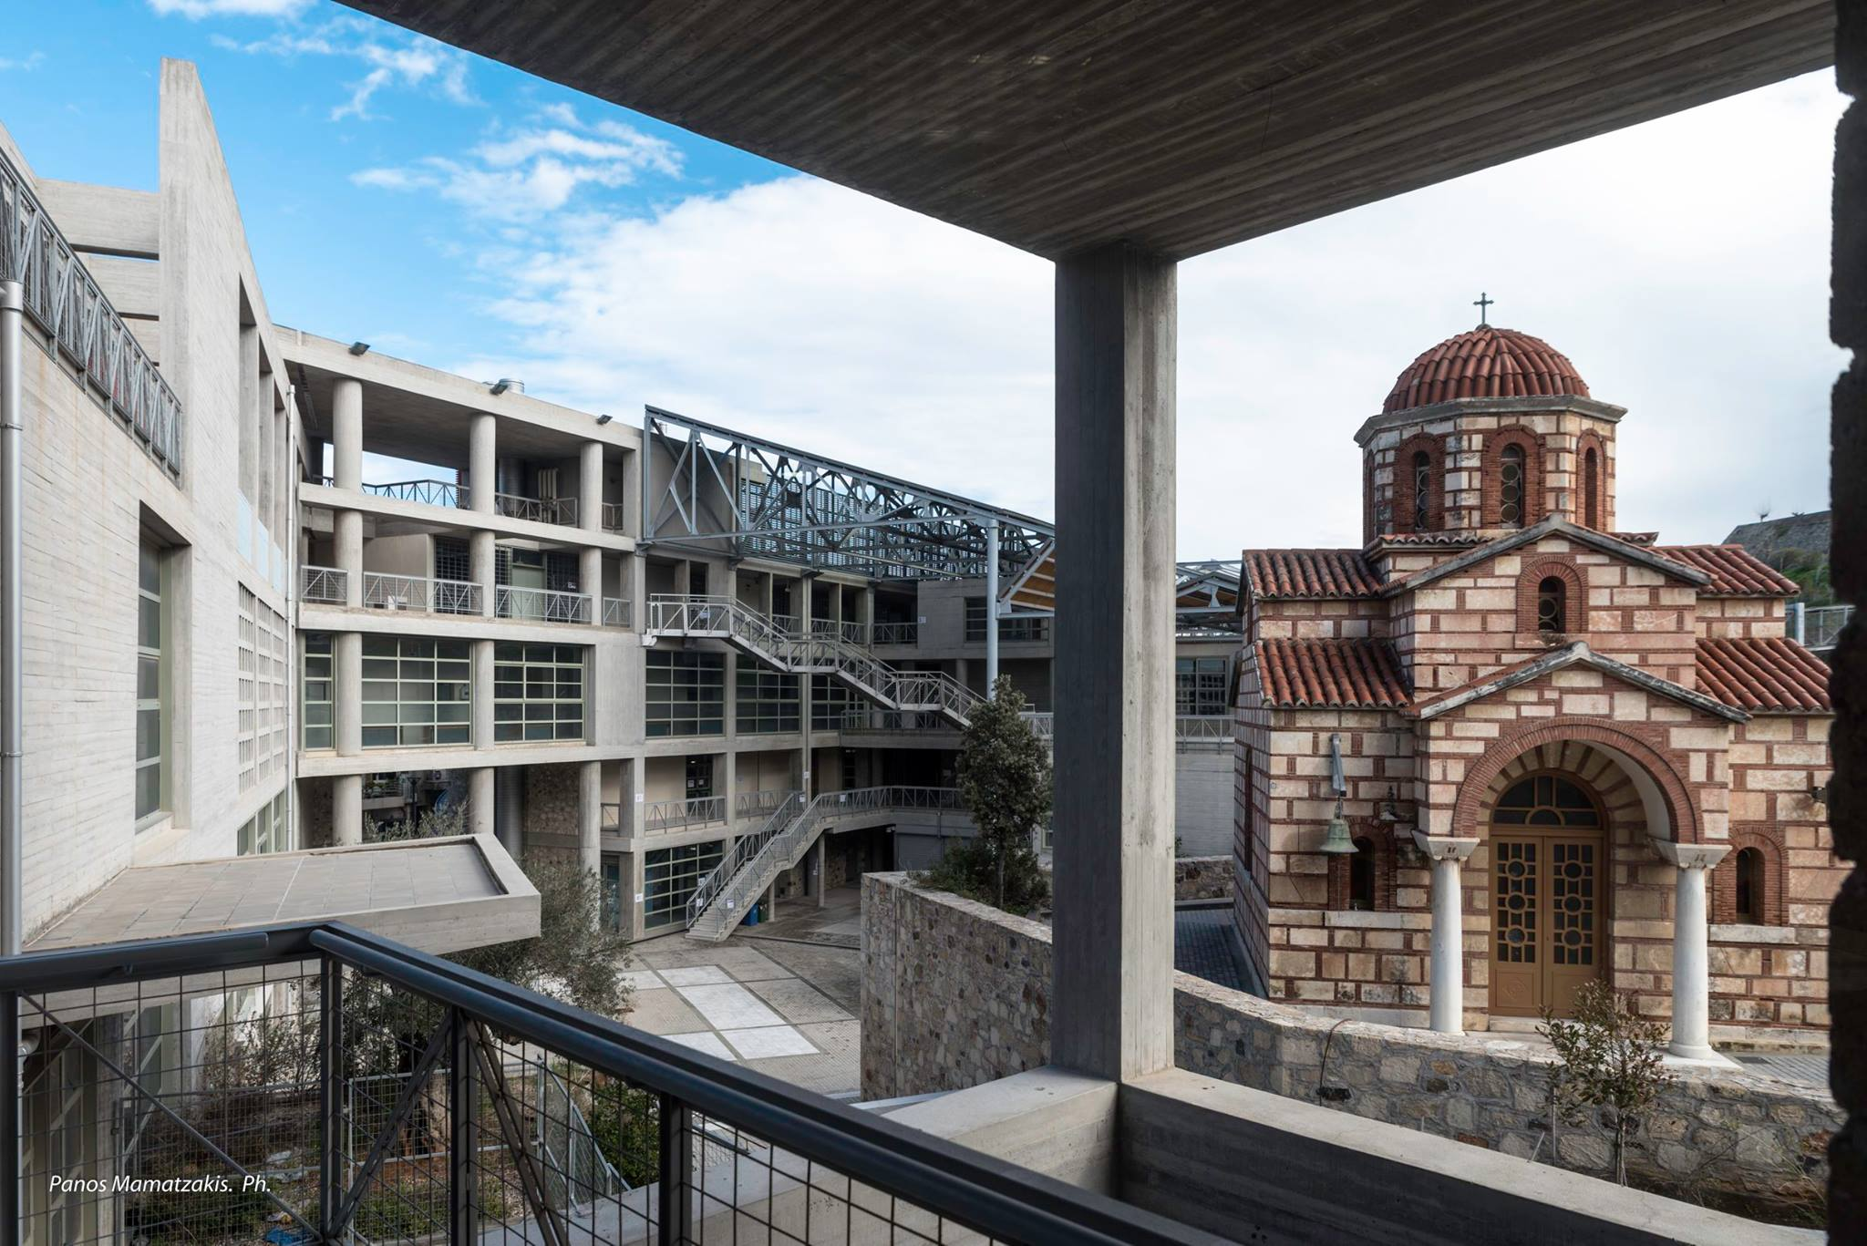
Thank you!

